Slide 1
Pointers

Slide 2
Pointers
Syntax:
datatype *var_name;
int *ptr; // ptr can point to an address which holds int data

Slide 3
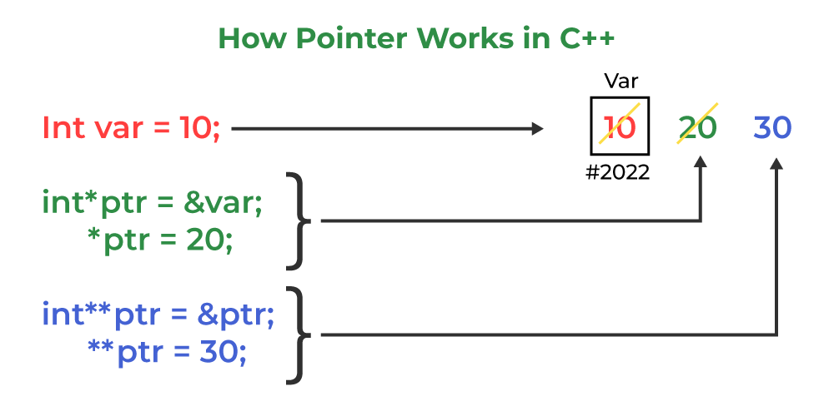
Pointers

Slide 4
#include <iostream.h>
using namespace std;
void geeks()
{
int var = 20;
int* ptr; // declare pointer variable
ptr = &var; // note that data type of ptr and var must be same
// assign the address of a variable to a pointer
cout << "Value at ptr = " << ptr << "\n";
cout << "Value at var = " << var << "\n";
cout << "Value at *ptr = " << *ptr << "\n";
}
int main()
{
geeks();
return 0;
}
Output
Value at ptr = 0x7ffe454c08cc
Value at var = 20
Value at *ptr = 20

Slide 5
pass C++ arguments
There are 3 ways to pass C++ arguments to a function:
Call-By-Value
Call-By-Reference with a Pointer Argument
Call-By-Reference with a Reference Argument

Slide 6
// Pass-by-Value
int square1(int n)
{
// Address of n in square1() is not the same as n1 in
// main()
cout << "address of n1 in square1(): " << &n << "\n";
// clone modified inside the function
n *= n;
return n;
}
// Call-by-Value
int n1 = 8;
cout << "address of n1 in main(): " << &n1 << "\n";
cout << "Square of n1: " << square1(n1) << "\n";
cout << "No change in n1: " << n1 << "\n";
address of n1 in main(): 0x7fffa7e2de64
address of n1 in square1(): 0x7fffa7e2de4c
Square of n1: 64
No change in n1: 8

Slide 7
// Pass-by-Reference with Pointer Arguments
void square2(int* n)
{
// Address of n in square2() is the same as n2 in main()
cout << "address of n2 in square2(): " << n << "\n";
// Explicit de-referencing to get the value pointed-to
*n *= *n;
}
// Call-by-Reference with Pointer Arguments
int n2 = 8;
cout << "address of n2 in main(): " << &n2 << "\n";
square2(&n2);
cout << "Square of n2: " << n2 << "\n";
cout << "Change reflected in n2: " << n2 << "\n";
address of n2 in main(): 0x7fffa7e2de68
address of n2 in square2(): 0x7fffa7e2de68
Square of n2: 64
Change reflected in n2: 64

Slide 8
// Pass-by-Reference with Reference Arguments
void square3(int& n)
{
// Address of n in square3() is the same as n3 in main()
cout << "address of n3 in square3(): " << &n << "\n";
// Implicit de-referencing (without '*')
n *= n;
}
// Call-by-Reference with Reference Arguments
int n3 = 8;
cout << "address of n3 in main(): " << &n3 << "\n";
square3(n3);
cout << "Square of n3: " << n3 << "\n";
cout << "Change reflected in n3: " << n3 << "\n";
address of n3 in main(): 0x7fffa7e2de6c
address of n3 in square3(): 0x7fffa7e2de6c
Square of n3: 64
Change reflected in n3: 64

Slide 9
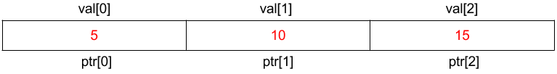
Array Name as Pointers
An array name contains the address of the first element of the array which acts like a constant pointer. It means, the address stored in the array name can’t be changed. For example, if we have an array named val then val and &val[0] can be used interchangeably.
void main ()
{
// Declare an array
int val[3] = { 5, 10, 15 };
// declare pointer variable
int* ptr;
// Assign the address of val[0] to ptr
// We can use ptr=&val[0];(both are same)
ptr = val;
cout << "Elements of the array are: ";
cout << ptr[0] << " " << ptr[1] << " " << ptr[2];
}

Slide 10
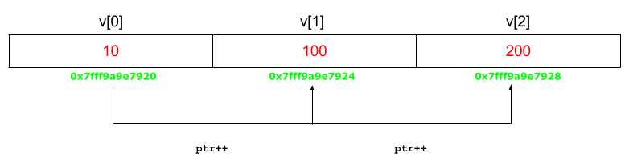
void main ()
{
// Declare an array
int v[3] = { 10, 100, 200 };
// declare pointer variable
int* ptr;
// Assign the address of v[0] to ptr
ptr = v;
for (int i = 0; i < 3; i++) {
cout << "Value at ptr = " << ptr << "\n";
cout << "Value at *ptr = " << *ptr << "\n";
// Increment pointer ptr by 1
ptr++;
}
}

Slide 11
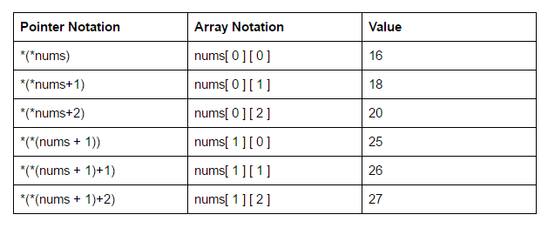
int nums[2][3] = { { 16, 18, 20 }, { 25, 26, 27 } };

Slide 12
Advantages of Pointers
Pointers reduce the code and improve performance. They are used to retrieve strings, trees, arrays, structures, and functions.
Pointers allow us to return multiple values from functions.
In addition to this, pointers allow us to access a memory location in the computer’s memory.

